Slide 1

Horror Movie Trends
Ben, Danielle, Joe, rothana

Slide 2
Motivation and Interest
With Halloween just passing while picking our projects our group thought it would be interesting to see how horror movie interest and ratings have trended over the past few years. The first data set we found had horror movies ranging from 2012-2017 but we wanted to expand upon this time frame. This led us to include a Netflix data set allowing us to expand our analysis using the streaming services. Not only was the theme of interest but these data sets were a good introduction for cleaning data.
Questions addressed in this analysis
Release Date Analysis (Roth):
What is the change in average ratings between 2012 and 2017?
Which release month is the most popular for each country in the data set?
Country Analysis (Ben):
What country spends the most on average per movie?
What is the relationship between rating average and country?
Rating Analysis (Danielle):
What is the correlation between rating and movie duration?
What is the correlation between rating and location setting?
Netflix Analysis (Joe):
Number of horror movie release vs total release per year?
Was the number of releases effected by the pandemic?

Slide 3
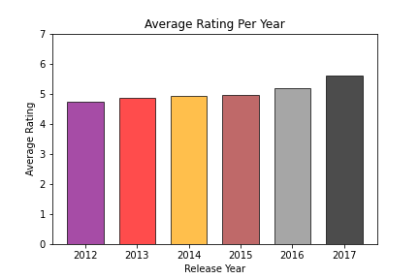
Release Date Analysis: Question 1
What is the change in average ratings between 2012 and 2017?
Within the timeframe, the average review rating increased slightly per year.
Notice a rise in the horror genre just by the looks of it.
5.59
4.92
4.97
5.20
4.74
4.85

Slide 4
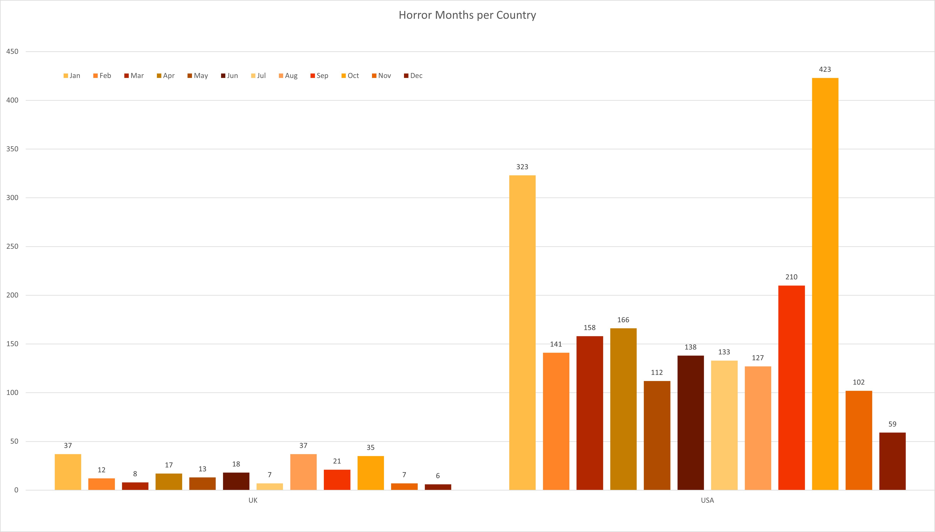
Release Date Analysis: Question 2
Which release month is the most popular for each country in the data set?
USA and UK are the top 2 data providers. Notice the release months being high in not only October, but January, August, and September.

Slide 5
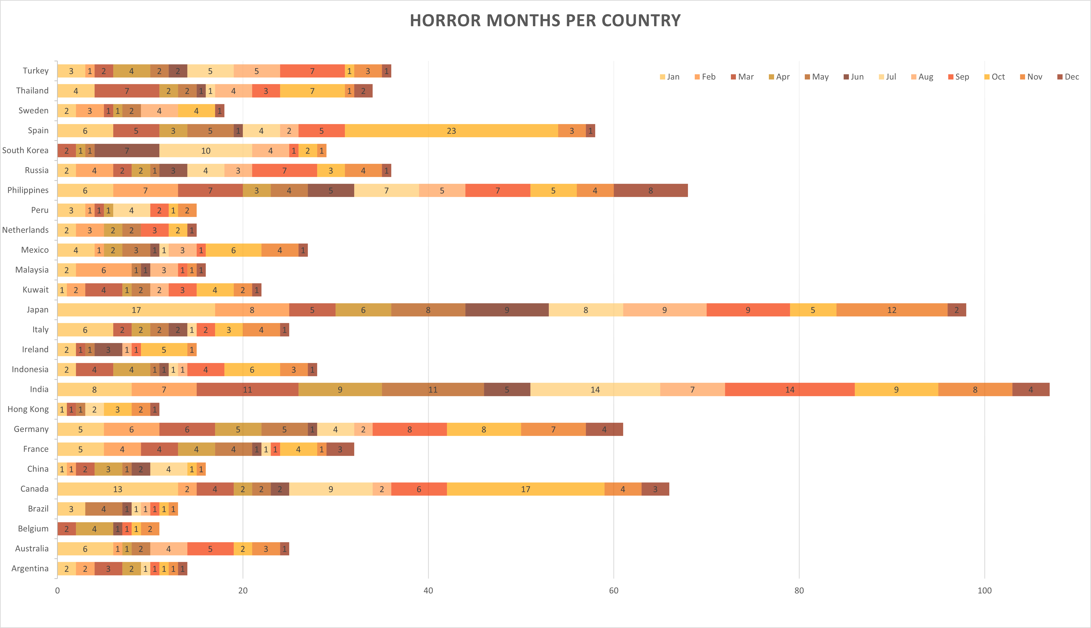

Slide 6
Country Analysis Facts 2012-2017
Highlights
14 countries out 55 were included in the analysis.
Cleaned data included: rows that had both a budget amount and a review rating.
India’s average budget is roughly $72 million more per movie than the United States.
US made 508 more movies during this period than the rest of the countries.
Release Country | Count | Budget | Review Rating
India | 29 | $ 76,950,800.00 | 5.95
Spain | 14 | $ 3,392,942.86 | 5.41
Italy | 10 | $ 671,150.00 | 5.39
France | 12 | $ 3,508,227.17 | 5.20
USA | 769 | $ 4,479,284.94 | 5.11
Mexico | 9 | $ 2,809,111.11 | 5.11
UK | 79 | $ 1,053,899.28 | 5.07
Canada | 22 | $ 553,251.41 | 5.05
Russia | 18 | $ 16,993,718.06 | 4.81
Philippines | 14 | $ 8,795,928.57 | 4.75
Australia | 12 | $ 3,663,166.67 | 4.46
Germany | 21 | $ 927,872.10 | 4.37
Japan | 11 | $ 3,385,727.27 | 4.12
Peru | 10 | $ 1,110,100.00 | 3.72
 | 1030 | $ 9,163,941.39 | 4.89

Slide 7
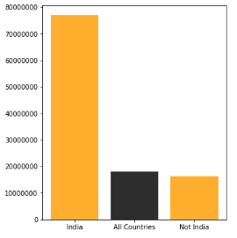
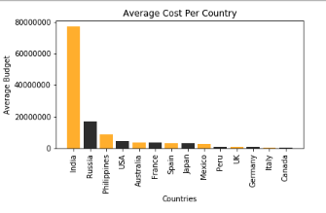
Country Analysis: Question 1
What country spends the most on average per movie?
India spent $60 million more than then the 2nd most spending country.
On average the other countries spend roughly $4 million per movie.

Slide 8
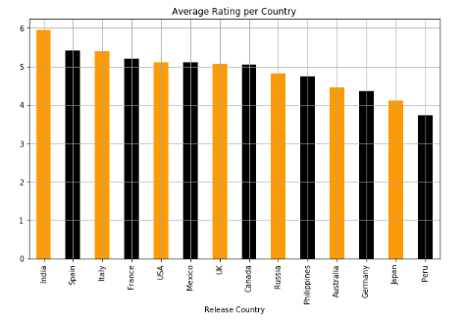
Country Analysis: Question 2
What is the relationship between rating average and country?
UK produced the second most movies, but the ratings were virtually identical to Canada.
India spent the most on average per movie and had the highest ratings.

Slide 9
Rating Analysis: Source Material
Can any of this data be used to provide incite on the ratings given?
Used IMDB Horror movie data set from Kaggle
Limitation of the data set include:
Missing data that was filtered out.
Unknown number of reviews.
Geoapify API was used
Geocode to get place id.
Places to get location type.
Dependent on data entered to be correct.

Slide 10
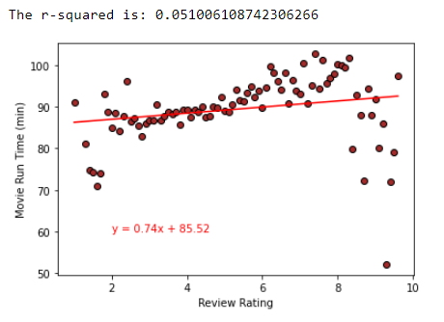
Rating Analysis: Question 1
What is the coloration between review rating and run time?
There is a weak coloration between review rating and movie run time.
From the r2 value we can also see the data does not fit the line well.
From the data given we can note the movie run time drops off with a rating above 8.

Slide 11
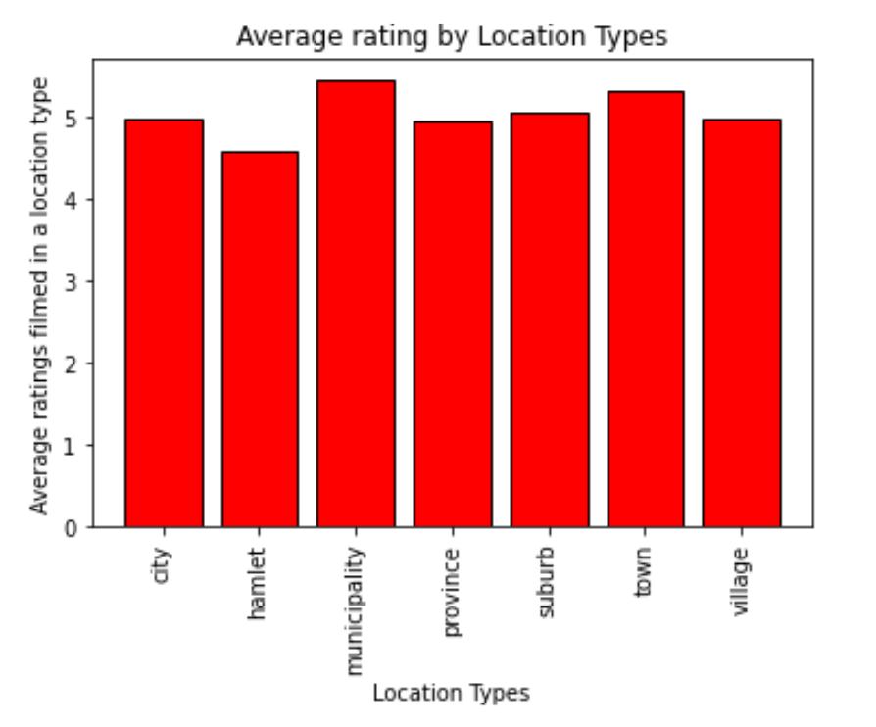
Rating Analysis: Question 2
Is there a significant difference between review ratings based on the location setting?
From this chart we can determine municipalities and towns tend to have higher ratings but are not significantly ahead.
Hamlets on the other hand are not the best setting for horror movies.

Slide 12
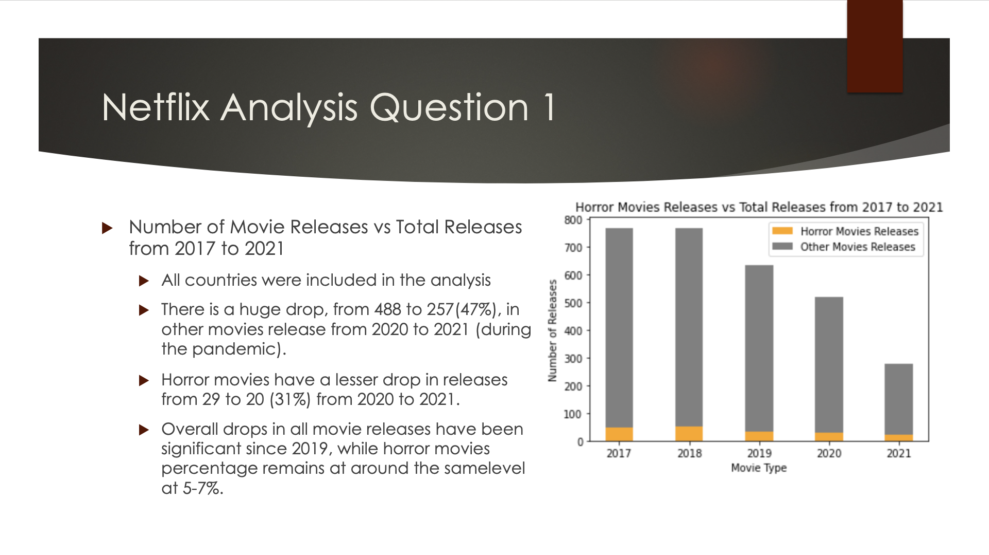

Slide 13
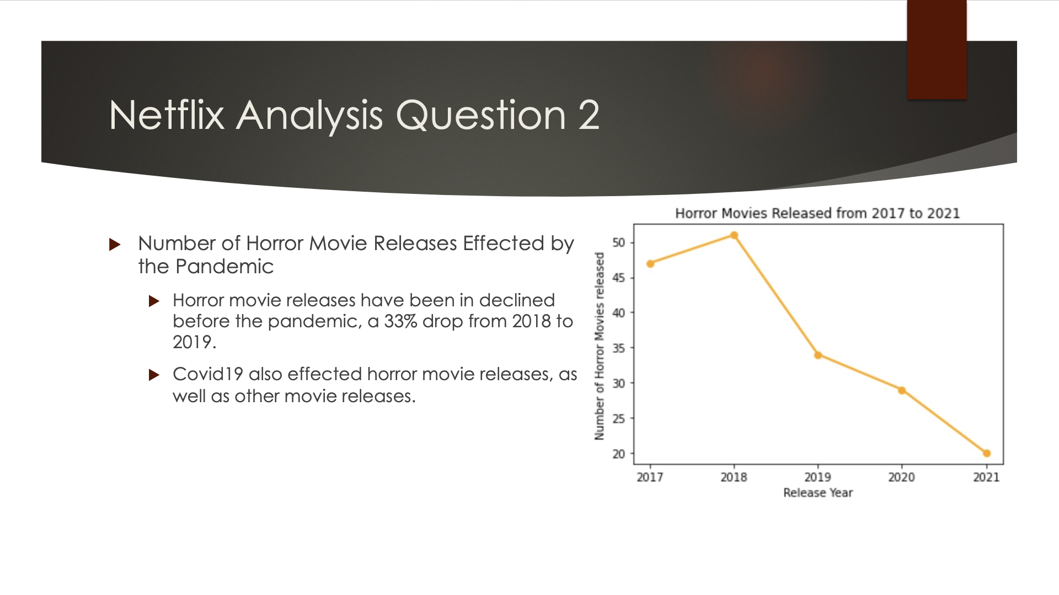

Slide 14
Questions?

